Slide 1
Lecture 22: Fourier Transforms

Slide 2
Properties of Fourier Transforms
Conjugate symmetry
Linearity
Time shift
Modulation
Convolution
Duality
Parseval’s theorem
Integration
Differentiation

Slide 3
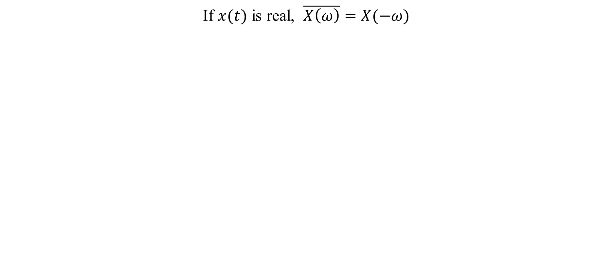
1. Conjugate symmetry
If $x(t)$ is real, $\overline{X\left(ω\right)}=$ $X(−ω)$

Slide 4
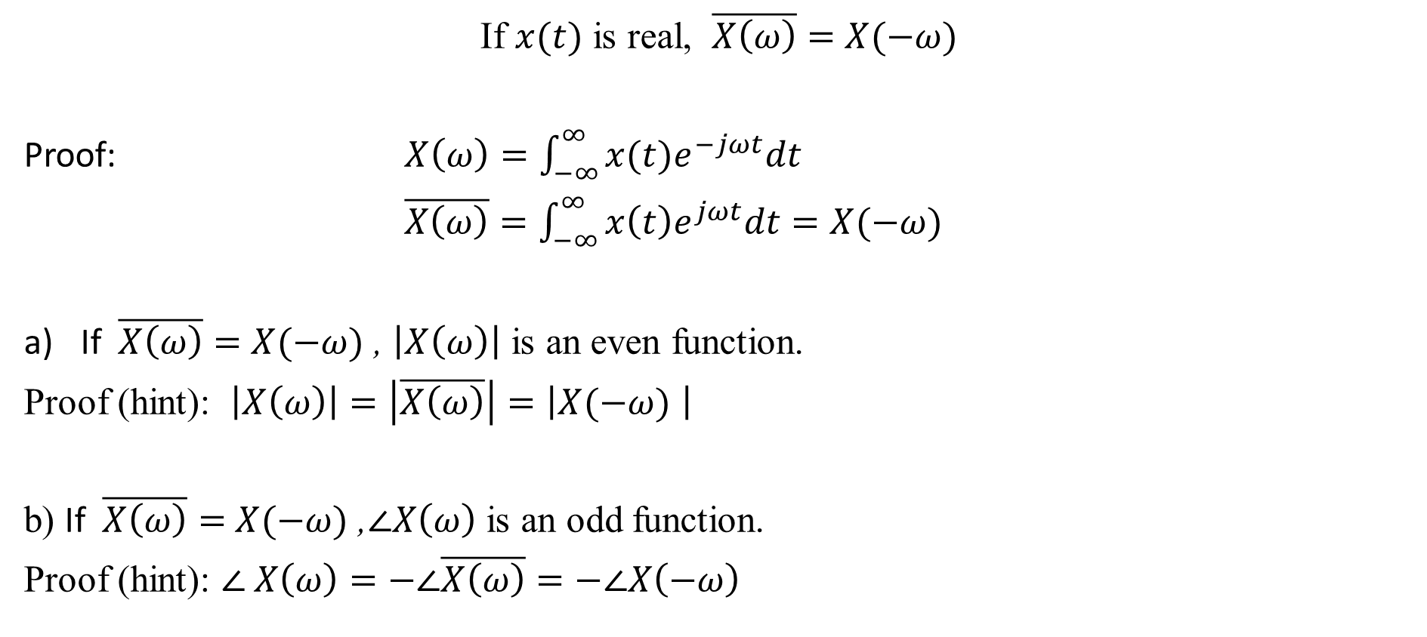
1. Conjugate symmetry
If $x(t)$ is real, $\overline{X\left(ω\right)}=$ $X(−ω)$
Proof: $X\left(ω\right)=\int_{−∞}^{∞}{x(t)e^{−jωt}dt}$
$\overline{X\left(ω\right)}=\int_{−∞}^{∞}{x\left(t\right)e^{jωt}dt=X(−ω)}$
If $\overline{X\left(ω\right)}=$ $X(−ω)$ , $\left|X\left(ω\right)\right|$ is an even function.
Proof (hint): $\left|X\left(ω\right)\right|=\left|\overline{X\left(ω\right)}\right|=\left|X(−ω) \right|$
b) If $\overline{X\left(ω\right)}=$ $X(−ω)$ ,$∠X\left(ω\right)$ is an odd function.
Proof (hint): $∠ X\left(ω\right)=−∠\overline{X\left(ω\right)}=−∠X\left(−ω\right)$

Slide 5
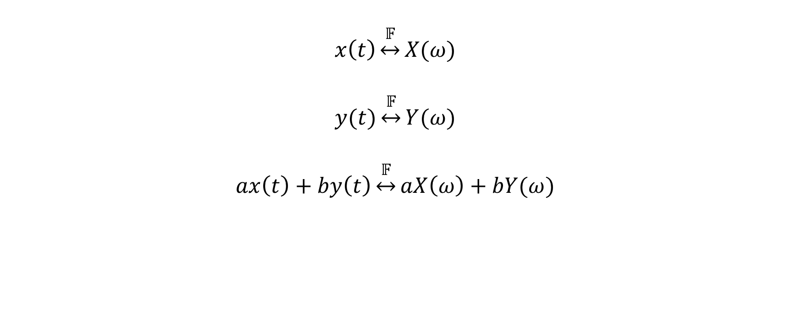
2. Linearity
$$x\left(t\right)\underset{↔}{𝔽}X(ω)$$
$$y(t)\underset{↔}{𝔽}Y(ω)$$
$$ax\left(t\right)+by\left(t\right)\underset{↔}{𝔽}aX\left(ω\right)+bY(ω)$$

Slide 6
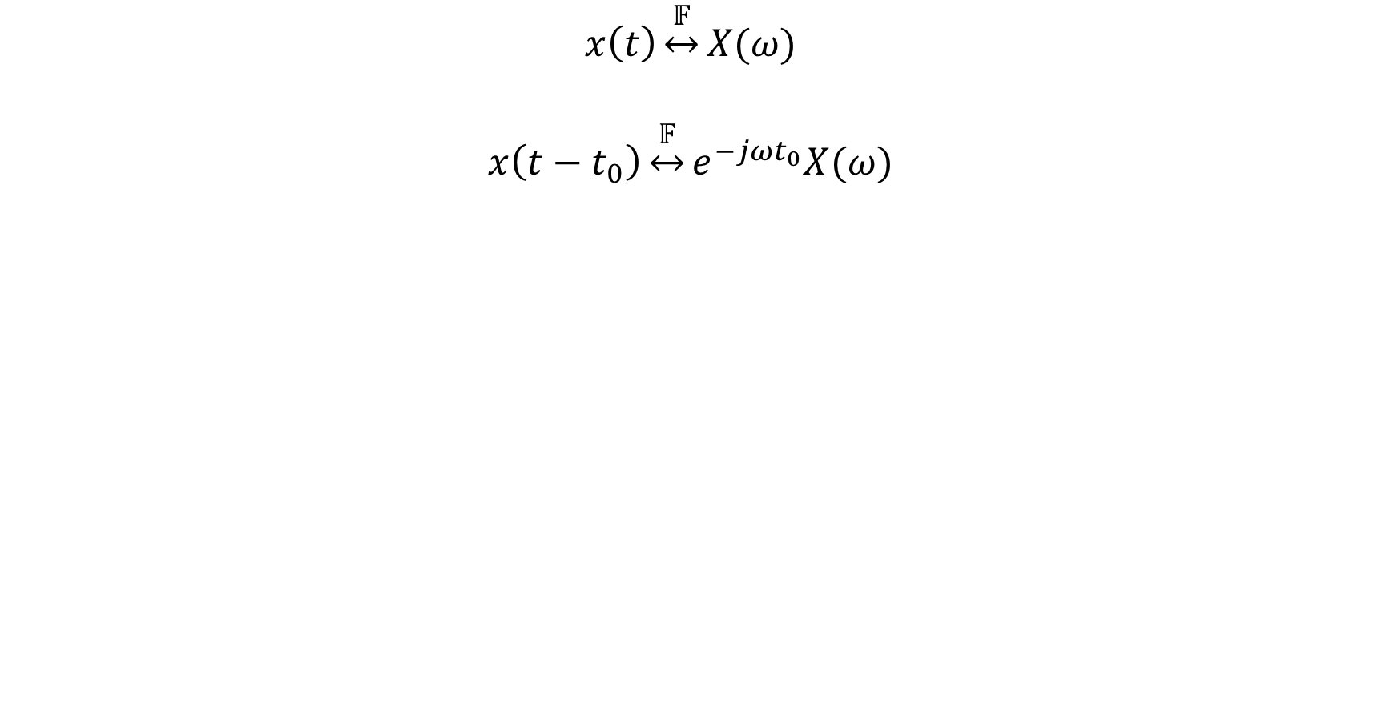
3. Time-shift
$$x\left(t\right)\underset{↔}{𝔽}X(ω)$$
$$x\left(t−t_{0}\right)\underset{↔}{𝔽}e^{−jωt_{0}}X(ω)$$

Slide 7
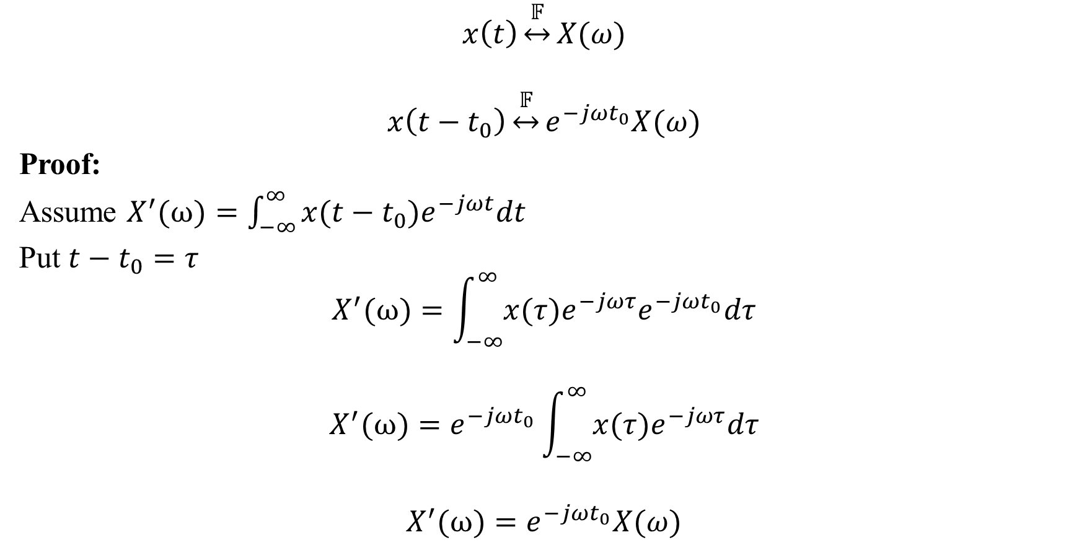
3. Time-shift
$$x\left(t\right)\underset{↔}{𝔽}X(ω)$$
$$x\left(t−t_{0}\right)\underset{↔}{𝔽}e^{−jωt_{0}}X(ω)$$
Proof:
Assume $X^{′}(ω)=\int_{−∞}^{∞}{x(t−t_{0})e^{−jωt}dt}$
Put $t−t_{0}=τ$
$$X^{′}(ω)=\int_{−∞}^{∞}{x(τ)e^{−jωτ}e^{−jωt_{0}}dτ}$$
$$X^{′}(ω)=e^{−jωt_{0}}\int_{−∞}^{∞}{x(τ)e^{−jωτ}dτ}$$
$$X^{′}(ω)=e^{−jωt_{0}}X(ω)$$

Slide 8

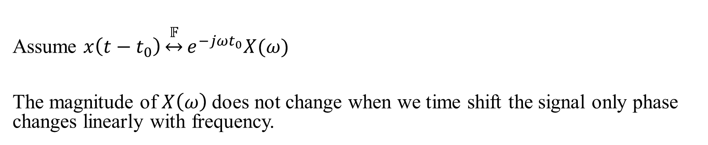

Physical Interpretation of Time-Shift
Assume $x\left(t−t_{0}\right)\underset{↔}{𝔽}e^{−jωt_{0}}X(ω)$
The magnitude of $X\left(ω\right)$does not change when we time shift the signal only phase changes linearly with frequency.
$$∆φ$$
$$ω$$

Slide 9
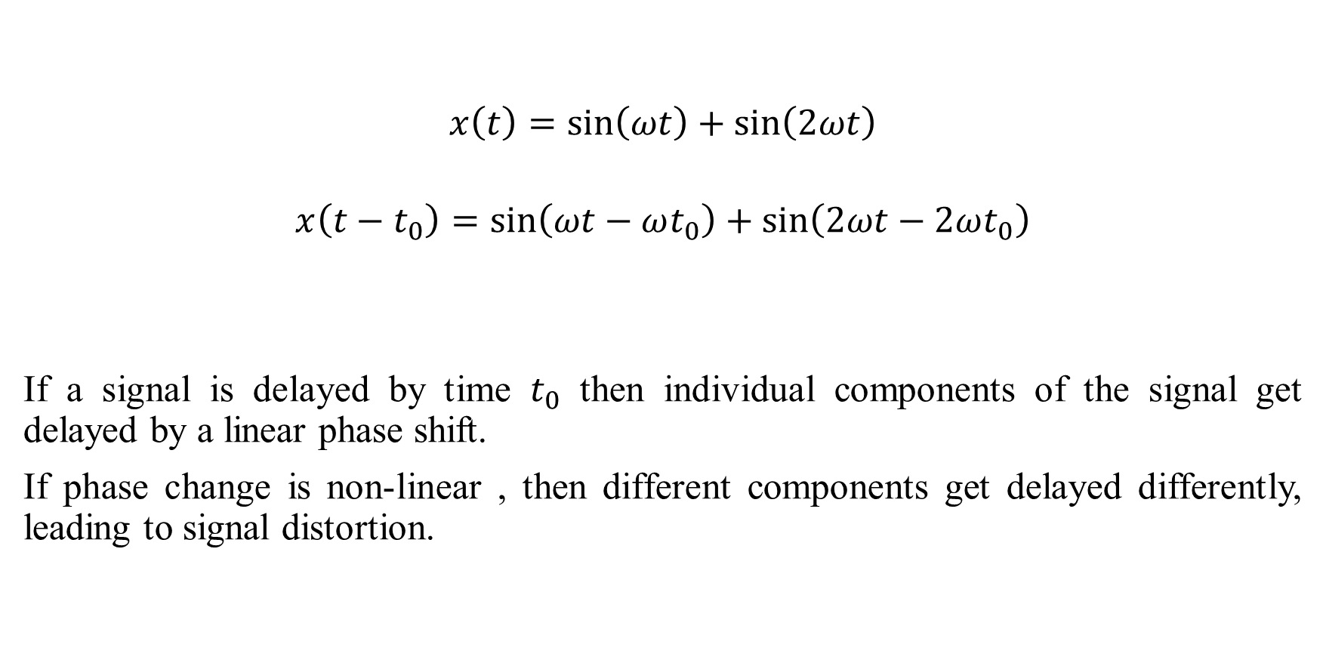
Physical Interpretation of Time-Shift
$$x\left(t\right)=\sin\left(ωt\right)+\sin\left(2ωt\right)$$
$$x\left(t−t_{0}\right)=\sin\left(ωt−ωt_{0}\right)+\sin\left(2ωt−2ωt_{0}\right)$$
If a signal is delayed by time $t_{0}$ then individual components of the signal get delayed by a linear phase shift.
If phase change is non-linear , then different components get delayed differently, leading to signal distortion.

Slide 10
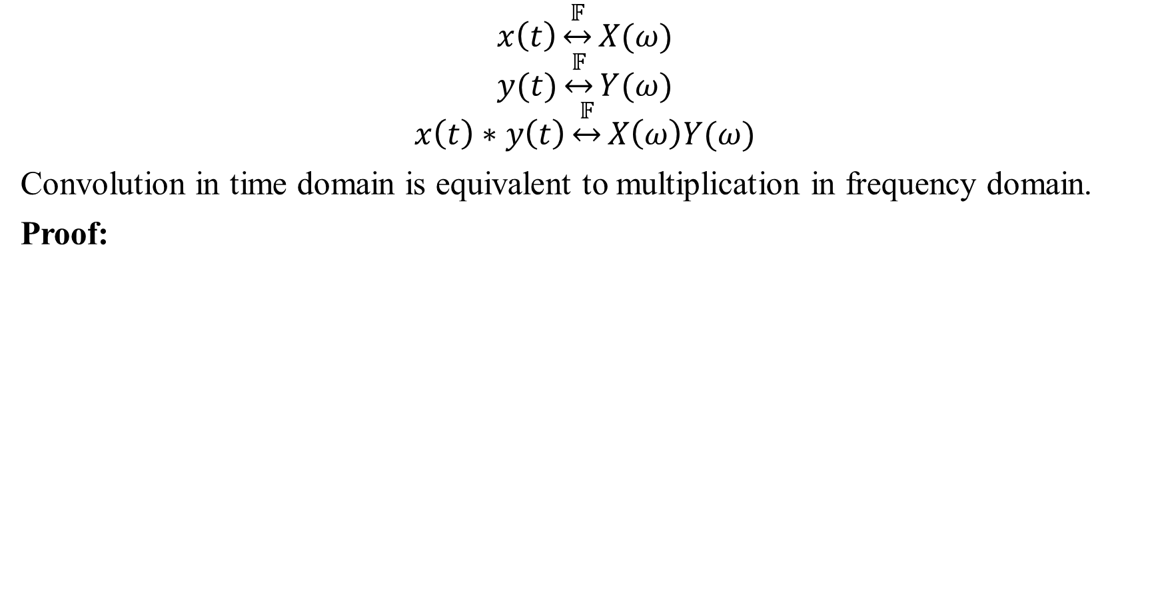
4. Convolution
$$x\left(t\right)\underset{↔}{𝔽}X(ω)$$
$$y(t)\underset{↔}{𝔽}Y(ω)$$
$$x\left(t\right)∗y\left(t\right)\underset{↔}{𝔽}X\left(ω\right)Y(ω)$$
Convolution in time domain is equivalent to multiplication in frequency domain.
Proof:

Slide 11
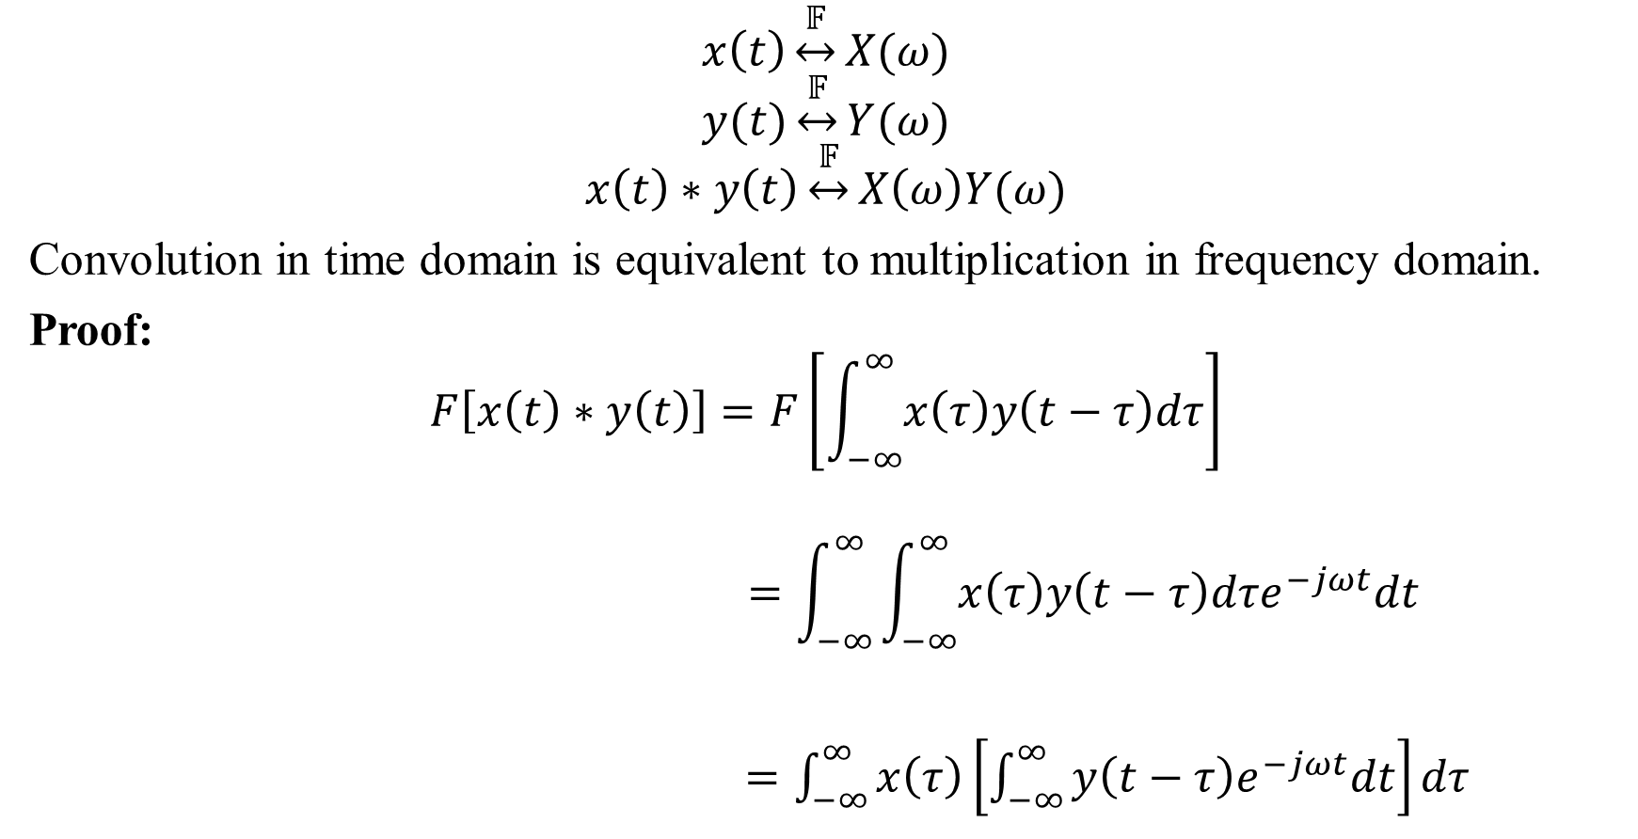
4. Convolution
$$x\left(t\right)\underset{↔}{𝔽}X(ω)$$
$$y(t)\underset{↔}{𝔽}Y(ω)$$
$$x\left(t\right)∗y\left(t\right)\underset{↔}{𝔽}X\left(ω\right)Y(ω)$$
Convolution in time domain is equivalent to multiplication in frequency domain.
Proof:
$$F\left[x\left(t\right)∗y\left(t\right)\right]=F\left[\int_{−∞}^{∞}{x\left(τ\right)y\left(t−τ\right)dτ}\right]$$
$$=\int_{−∞}^{∞}{\int_{−∞}^{∞}{x\left(τ\right)y\left(t−τ\right)dτe^{−jωt}dt}}$$
$=\int_{−∞}^{∞}{x\left(τ\right)\left[\int_{−∞}^{∞}{y\left(t−τ\right)e^{−jωt}dt}\right]}dτ$

Slide 12
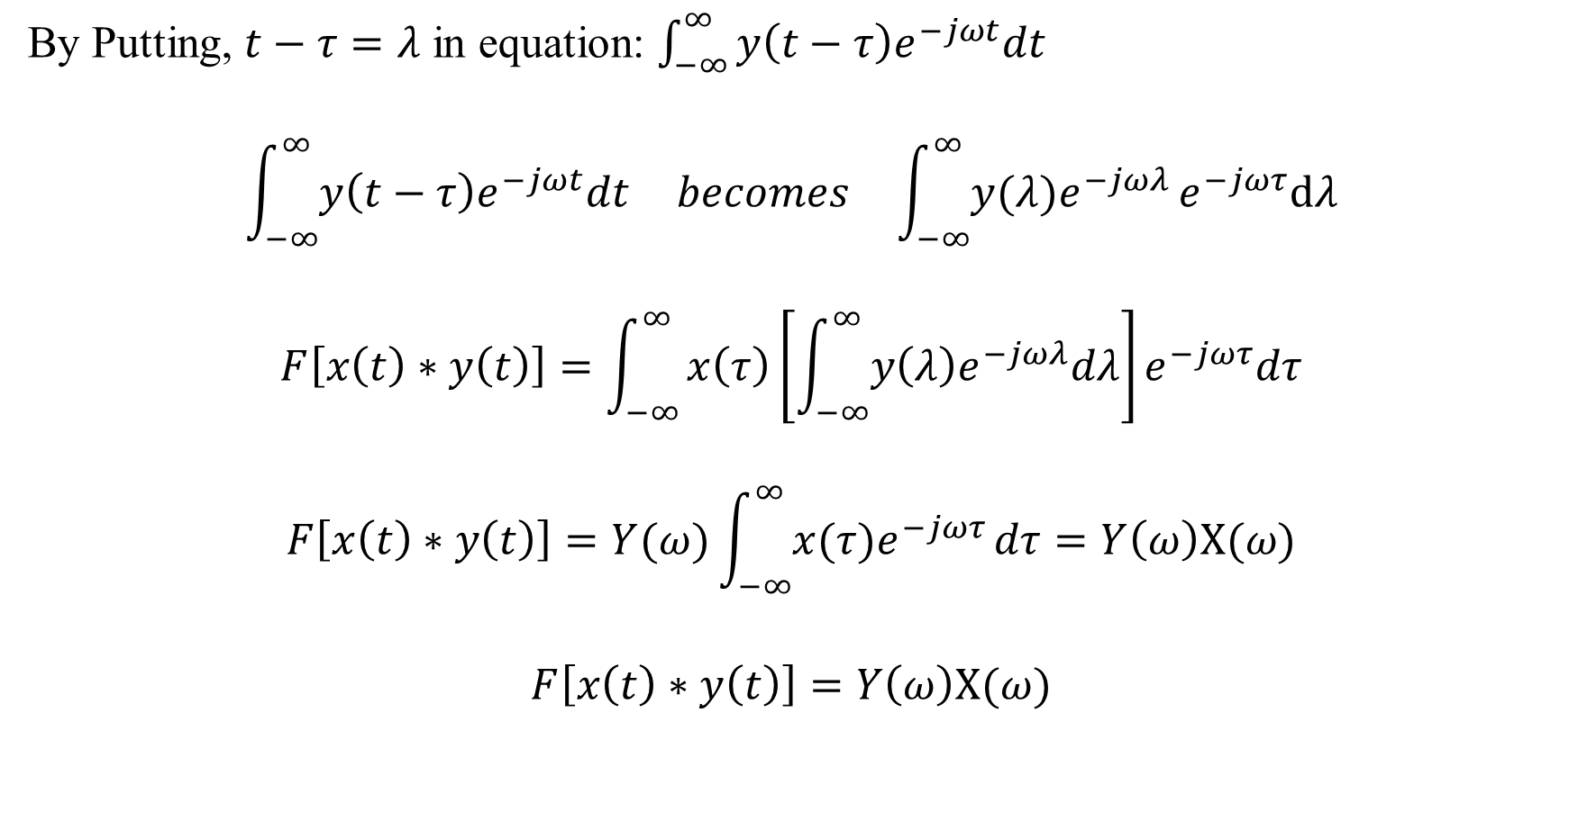
Convolution
By Putting, $t−τ=λ$ in equation: $\int_{−∞}^{∞}{y\left(t−τ\right)e^{−jωt}dt}$
$$\int_{−∞}^{∞}{y\left(t−τ\right)e^{−jωt}dt} becomes \int_{−∞}^{∞}{y(λ)e^{−jωλ}}e^{−jωτ}dλ$$
$$F\left[x\left(t\right)∗y\left(t\right)\right]=\int_{−∞}^{∞}{x\left(τ\right)\left[\int_{−∞}^{∞}{y\left(λ\right)e^{−jωλ}dλ}\right]}e^{−jωτ}dτ$$
$$F\left[x\left(t\right)∗y\left(t\right)\right]=Y(ω)\int_{−∞}^{∞}{x(τ)e^{−jωτ}}dτ=Y\left(ω\right)X(ω)$$
$$F\left[x\left(t\right)∗y\left(t\right)\right]=Y\left(ω\right)X(ω)$$

Slide 13

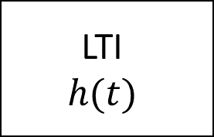

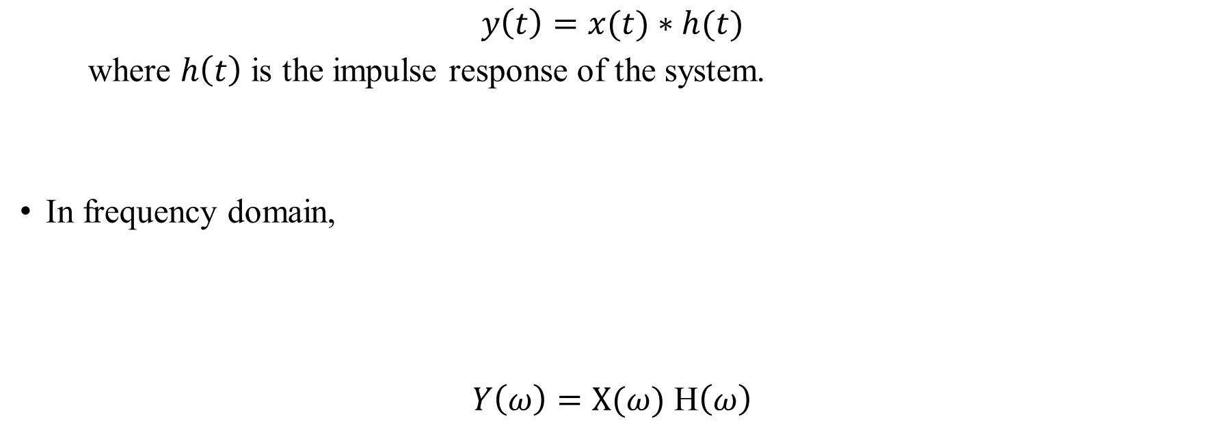
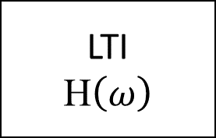


Convolution
$$x(t)$$
LTI
$$h(t)$$
$$y(t)$$
In time domain,
$$y\left(t\right)=x(t)∗h(t)$$
where $h\left(t\right)$ is the impulse response of the system.
In frequency domain,
$Y\left(ω\right)=X(ω)$ H$\left(ω\right)$
$$X(ω)$$
LTI
$$\text{H}\left(ω\right)$$
$$Y\left(ω\right)$$

Slide 15
Implications
Computationally efficient
LTI system cannot generate new frequencies
Frequency response provides point-wise decoupling

Slide 16
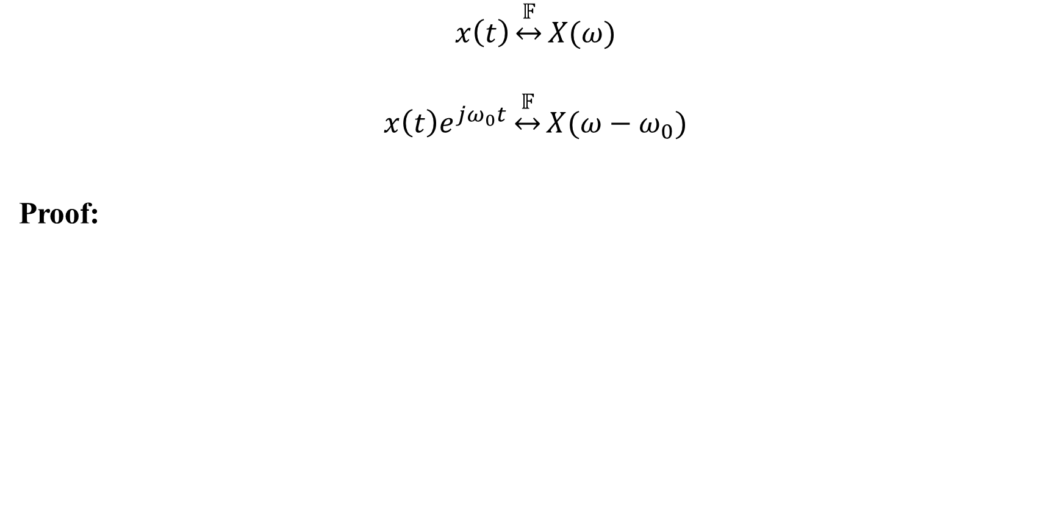
5. Modulation
$$x\left(t\right)\underset{↔}{𝔽}X(ω)$$
$$x\left(t\right)e^{jω_{0}t}\underset{↔}{𝔽}X(ω−ω_{0})$$
Proof:

Slide 17
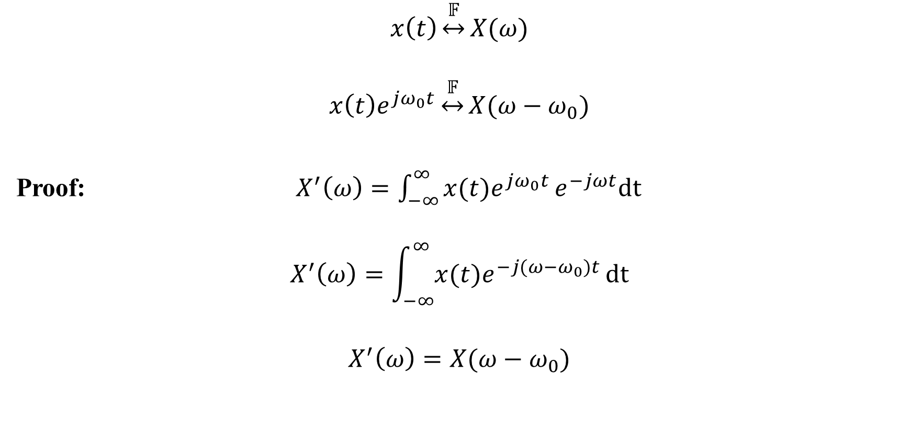
5. Modulation
$$x\left(t\right)\underset{↔}{𝔽}X(ω)$$
$$x\left(t\right)e^{jω_{0}t}\underset{↔}{𝔽}X(ω−ω_{0})$$
Proof: $X^{′}\left(ω\right)=\int_{−∞}^{∞}{x(t)e^{jω_{0}t}}e^{−jωt}dt$
$$X^{′}\left(ω\right)=\int_{−∞}^{∞}{x(t)e^{−j(ω−ω_{0})t}}dt$$
$$X^{′}\left(ω\right)=X(ω−ω_{0})$$

Slide 18

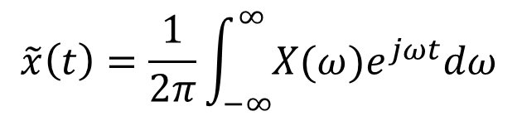




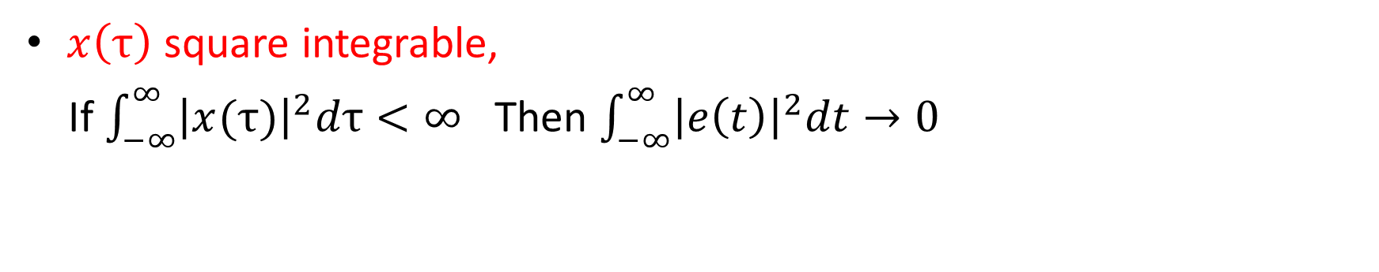



Modulation
$$X(f)$$
Speech signal (0-4 KHz)
$$f$$
$$0$$
$$4 KHz$$
Frequency response of a twisted pair
$$H(f)$$
$$H(f)$$
$$f$$
$$0$$
$$1 MHz$$
$$20 MHz$$

Slide 19



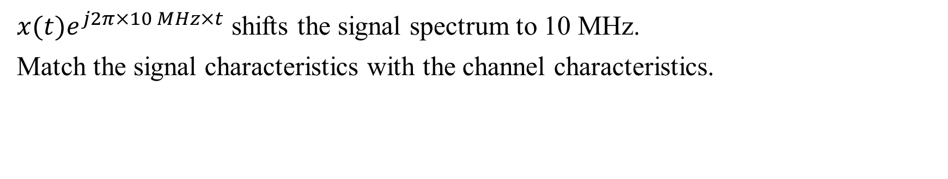
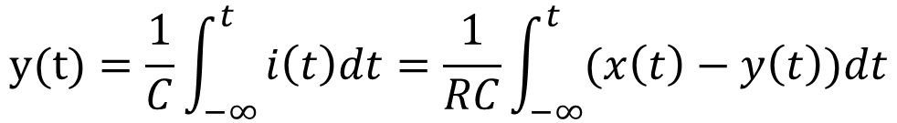

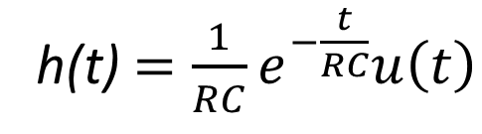


Modulation
$x(t)e^{j2π×10 MHz×t}$ shifts the signal spectrum to 10 MHz.
Match the signal characteristics with the channel characteristics.
$$X(f)$$
X’$(f)$
modulation
$$f$$
$$f$$
$$0$$
$$4 KHz$$
$$10 MHz$$
$$10 MHz+4 KHz$$

Slide 20
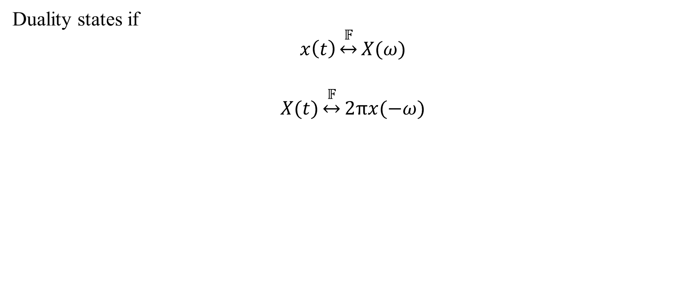
6. Duality
Duality states if
$$x\left(t\right)\underset{↔}{𝔽}X(ω)$$
$$X(t)\underset{↔}{𝔽}2πx(−ω)$$

Slide 21
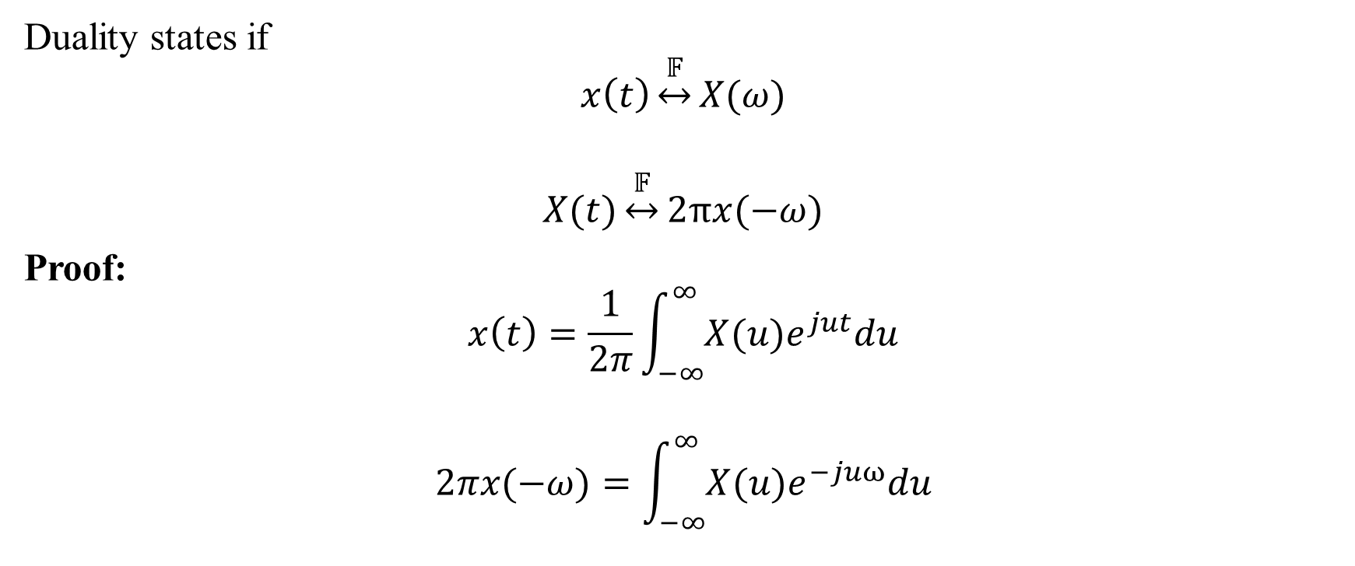
6. Duality
Duality states if
$$x\left(t\right)\underset{↔}{𝔽}X(ω)$$
$$X(t)\underset{↔}{𝔽}2πx(−ω)$$
Proof:
$$x\left(t\right)=\frac{1}{2π}\int_{−∞}^{∞}{X(u)e^{jut}du}$$
$$2πx(−ω)=\int_{−∞}^{∞}{X(u)e^{−juω}du}$$

